Slide 2
Chapter 5: Networking Concepts
IT Essentials v8.0
Notes:
Cisco Networking Academy Program
IT Essentials v8.0
Chapter 5: Networking Concepts

Slide 3
Chapter 5 - Sections & Objectives
5.1 Network Components and Types
Explain components and types of computer networks.
Describe the types of networks.
Describe internet connection types.
5.2 Network Protocols, Standards, and Services
Explain networking protocols, standards and services.
Explain the purpose and characteristics of transport layer protocols.
Explain the significance of application port numbers.
Explain wireless protocols.
Explain network services.
Notes:
3
Cisco Networking Academy Program
IT Essentials v8.0
Chapter 5: Networking Concepts

Slide 4
Chapter 5 - Sections & Objectives (Cont.)
5.3 Network Devices
Explain the purpose of devices on a network.
Explain basic network devices.
Explain security devices.
Explain other network devices.
5.4 Network Cables
Explain the characteristics of network cables.
Describe networking tools and their purpose.
Explain the purpose and characteristics of common types of copper network cables and connectors.
Explain the purpose and characteristics of common types of fiber network cables and connectors.
Notes:
4
Cisco Networking Academy Program
IT Essentials v8.0
Chapter 5: Networking Concepts

Slide 5
5.1 Network Components and Types
Notes:
5 – Networking Concepts
5.1 – Network Components and Types

Slide 6
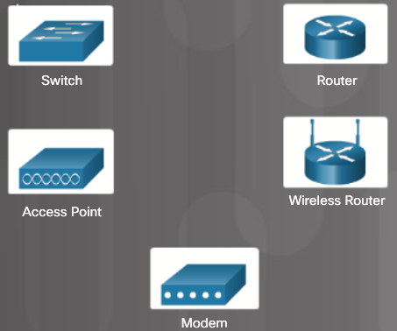
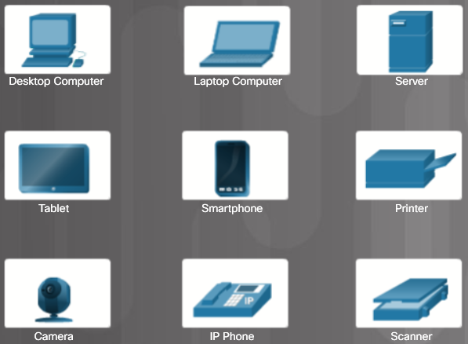
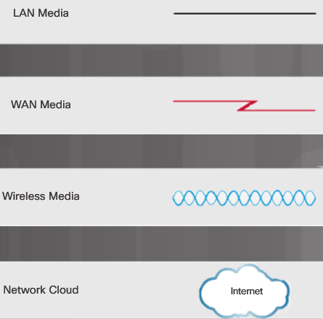
Types of Networks Network Icons
Network Media Icons
Intermediary Device Icons
Host Device Icons
Notes:
5.1 – Network Components and Types
5.1.1 – Types of Networks
5.1.1.1 – Network Icons

Slide 7
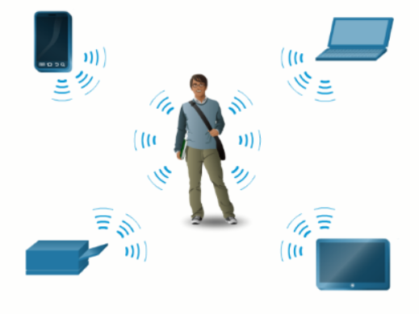
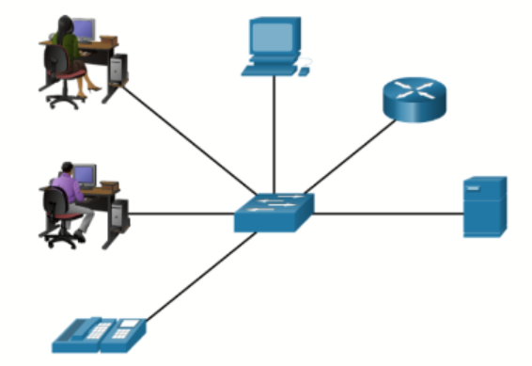
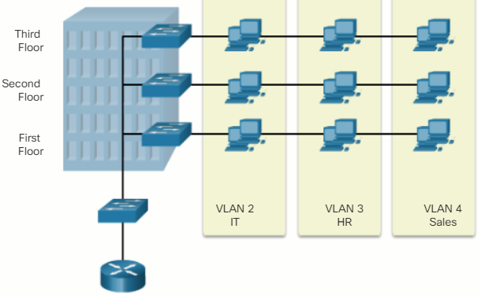
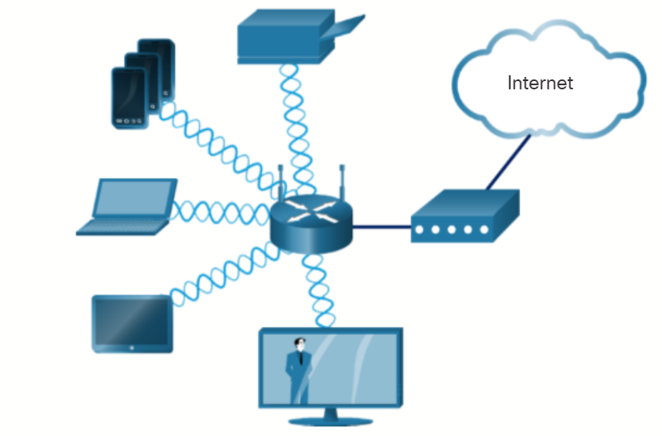
Types of Networks Network Topologies and Description
PAN (personal area network) – Commonly uses Bluetooth to connect mice, keyboards, phones, and tablets.
LAN (local area network) – A wired network consisting of a switch and network devices in a limited geographical area.
VLAN (virtual LAN) – Extends beyond a traditional LAN and groups users based on administratively defined boundaries such as department or floor.
WLAN (wireless LAN) – Connects multiple wireless devices and uses an access point.
Notes:
5.1 – Network Components and Types
5.1.1 – Types of Networks
5.1.1.2 – Network Topologies and Description

Slide 8
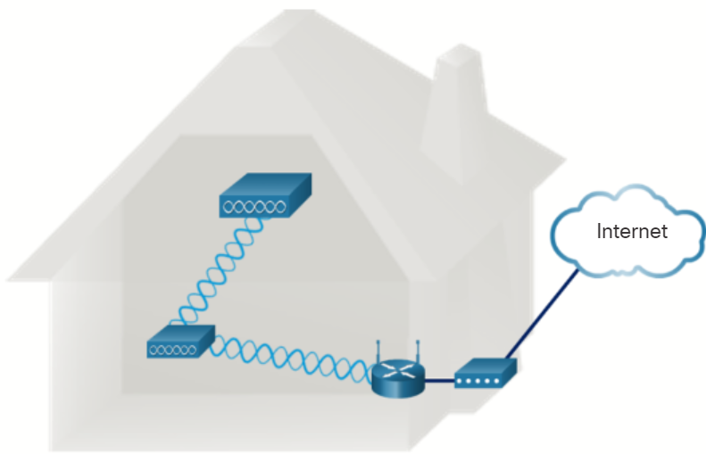
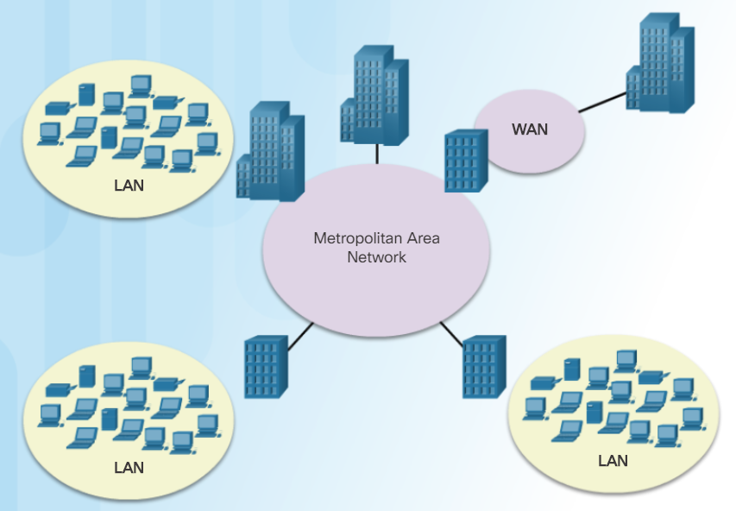
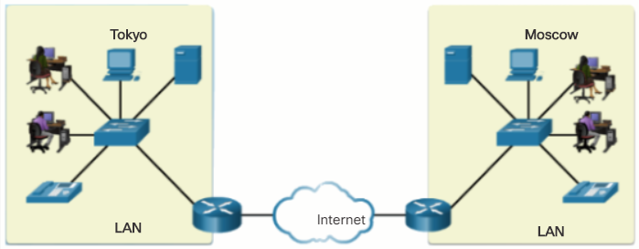
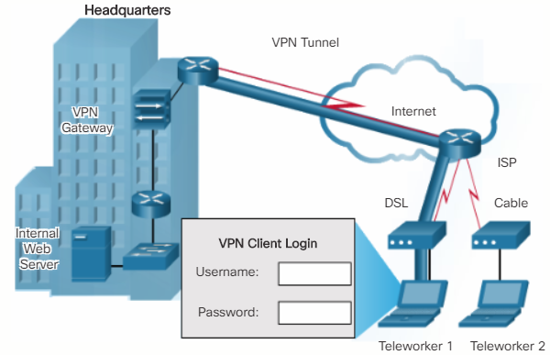
Types of Networks Network Topologies and Description (Cont.)
WMN (wireless mesh network) – Connects multiple wireless access points together to expand the wireless network.
MAN (metropolitan area network) – A network that spans a city.
WAN (wide area network) – A network that spans a large geographical area.
VPN (virtual private network) – A method of connecting to a network such as a company network across an unsecure network.
Notes:
5.1 – Network Components and Types
5.1.1 – Types of Networks
5.1.1.2 – Network Topologies and Description (Cont.)
5.1.1.3 – Check Your Understanding – Types of Networks

Slide 9
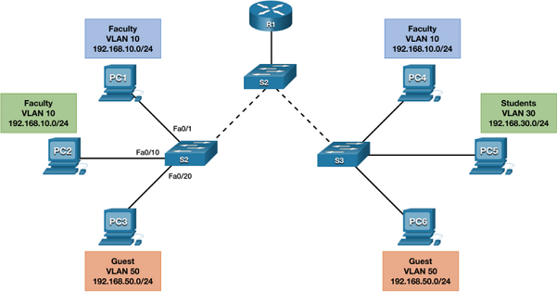
Types of Networks VLANs
They provide segmentation and organizational flexibility in a switched network.
A group of devices within a VLAN communicate as if each device was attached to the same switch.
VLANs are based on logical connections, instead of physical connections, and they can be segmented based on factors such as function, team, or application.
For example, a faculty member computer (PC1) is connected to S2 on VLAN 10.
PC1 could communicate with another faculty member using PC4 connected to S3.
Notice how both hosts are configured on network address 192.168.10.0/24.
By default, all switch ports are assigned to VLAN 1.
However, you can assign the PCs to different VLANs by configuring their interconnecting port.
Notes:
5.1 – Network Components and Types
5.1.1 – Types of Networks
5.1.1.4 – VLANs

Slide 10
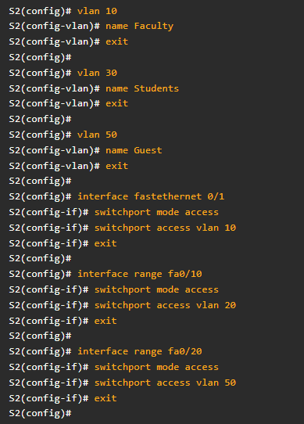
Types of Networks VLANs (Cont.)
Figure 2 displays a sample configuration of switch S2.
Notice that we first create the VLANs and assign them names.
This makes it easier to work with the VLANs.
Next, we configure the ports connecting to the PCs to the corresponding VLANs.
Once the VLAN information is configured on the other switches, the faculty member using PC1 would be able to communicate with PC4 because they are on the same VLANs.
If the faculty member wanted to send something to PC5 which is assigned to VLAN 30, then the services of a router would be required.
VLANs help reduce excessive broadcast traffic and implement access and security policies between groups of users.
Notes:
5.1 – Network Components and Types
5.1.1 – Types of Networks
5.1.1.4 – VLANs (Cont.)

Slide 11
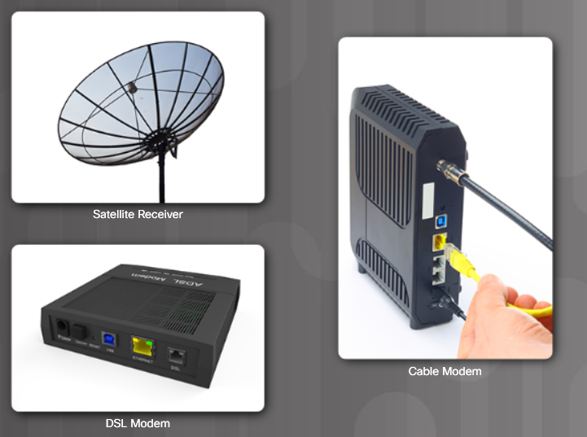
Internet Connection Types Brief History of Connection Technologies
Analog telephone access (dialup) – uses an analog modem to call another modem.
ISDN (Integrated Services Digital Network) – more bandwidth than dialup. Can carry voice, video, and data.
Broadband – uses different frequencies to send multiple signals over media.
Notes:
5.1 – Network Components and Types
5.1.2 – Internet Connection Types
5.1.2.1 – Brief History of Connection Technologies

Slide 12
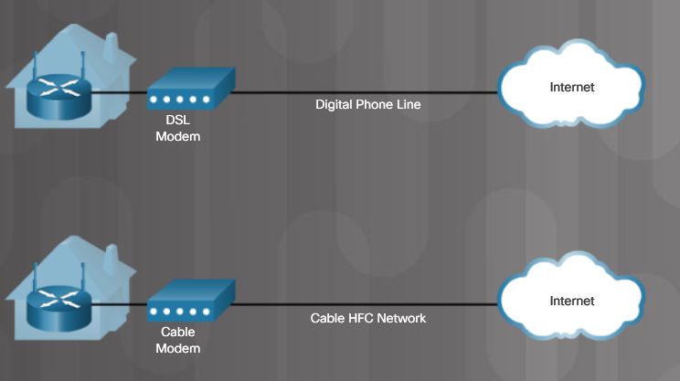
Internet Connection Types DSL, Cable, and Fiber
DSL (digital subscriber line) – always on technology that uses phone lines; voice and data carried on different frequencies; requires a filter on the port that connects to a phone.
Very high-speed DSL (VDSL) attains much higher bit rates than DSL. A symmetric link can carry as much as 26 Mbps in both directions while an asymmetric link can carry as much as 52 Mbps download and 6 Mbps upload. VDSL2 can carry as much as 100 Mbps in both directions.
Cable – Uses a cable modem to connect to a traditional cable TV network; shares the network with multiple subscribers.
Fiber – High bandwidth connection used in backbone networks, large enterprise environments, large data centers, and now part of some home internet connections.
In the figure, the cable connection includes a HFC network in which fiber is used in the last mile to the user’s home, and at the user’s home the network switches back to copper coaxial cable (FTTC).
Fiber to the premises (FTTP) brings the fiber to the customer’s building.
Notes:
5.1 – Network Components and Types
5.1.2 – Internet Connection Types
5.1.2.2 – DSL, Cable, and Fiber

Slide 13
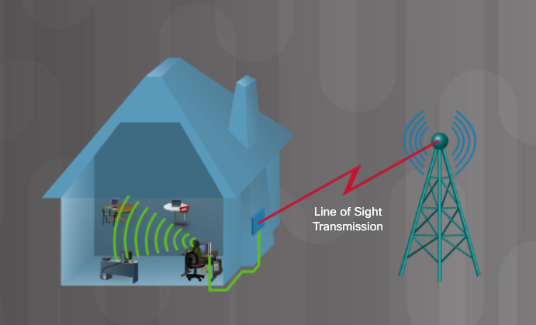
Internet Connection Types Line of Sight Wireless Internet Service
Line of site wireless – always on technology that uses radio signals for connecting to the internet.
Clear path required
Weather affects signal strength and performance
Notes:
5.1 – Network Components and Types
5.1.2 – Internet Connection Types
5.1.2.3 – Line of Sight Wireless Internet Service

Slide 14
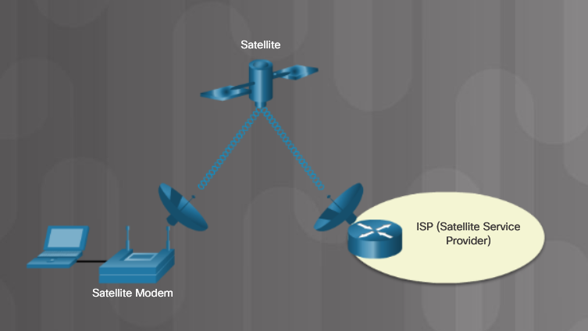
Internet Connection Types Satellite
Satellite – broadband technology for remote areas
Uses a satellite dish
Not a good solution for time-sensitive applications like gaming, Voice over Internet Protocol (VoIP), and video conferencing
Low Earth Orbit (LEO) – far more satellites orbiting the Earth in low Earth orbit
Can support up to approximately 100 Mbps
Much lower latency than standard satellite, between 100 and 200 ms
Notes:
5.1 – Network Components and Types
5.1.2 – Internet Connection Types
5.1.2.4 – Satellite

Slide 15
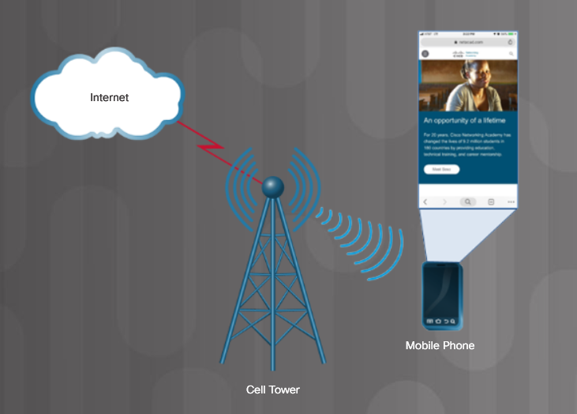
Internet Connection Types Cellular
Cellular– relies on cell towers to create a network used by cell phones and connectivity to the internet
Notes:
5.1 – Network Components and Types
5.1.2 – Internet Connection Types
5.1.2.5 – Cellular

Slide 16
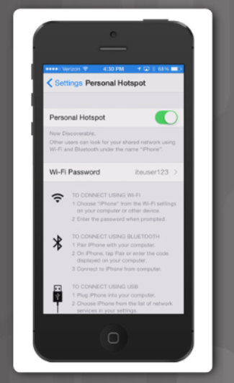
Internet Connection Types Mobile Hotspot and Tethering
Cell phone option that allows another device to connect to the internet using Wi-Fi, Bluetooth, or USB cable
The other device is using the phone’s cellular connection to connect to the internet
Called tethering or a hotspot
A mobile hotspot is when a cell phone allows Wi-Fi devices to connect and use the mobile data network.
Notes:
5.1 – Network Components and Types
5.1.2 – Internet Connection Types
5.1.2.6 – Mobile Hotspot and Tethering
5.1.2.7 – Check Your Understanding – Internet Connection Types

Slide 17
5.2 Networking Protocols, Standards, and Services
Notes:
5 – Networking Concepts
5.2 – Networking Protocols, Standards, and Services

Slide 18
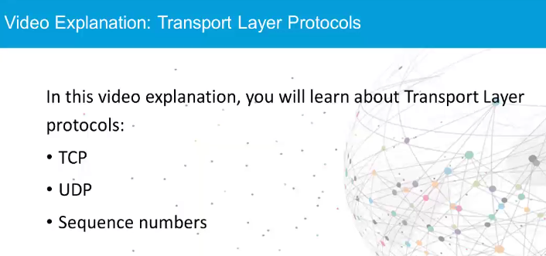
Video Explanation – Transport Layer Protocols Transport Layer Protocols
Notes:
5.2 – Network Protocols, Standards, and Services
5.2.1 – Transport Layer Protocols
5.2.1.1 – Video Explanation – Transport Layer Protocols
5.2.1.2 – Activity – Transport Layer Protocols

Slide 19
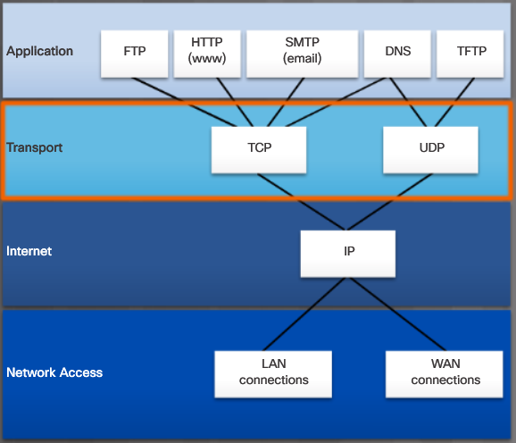
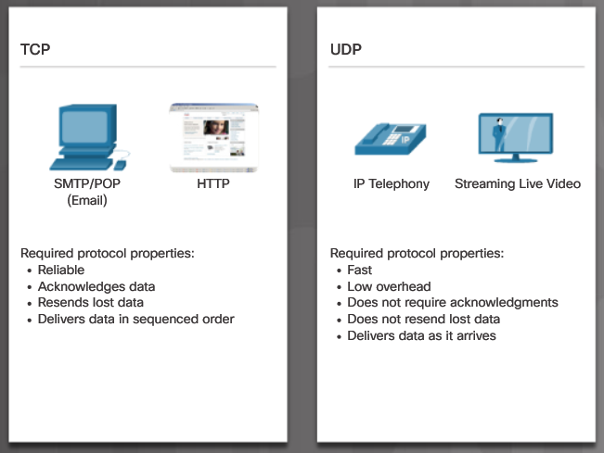
Transport Layer Protocols The TCP/IP Model
Notes:
5.2 – Network Protocols, Standards, and Services
5.2.1 – Transport Layer Protocols
5.2.1.3 – The TCP/IP Model

Slide 20
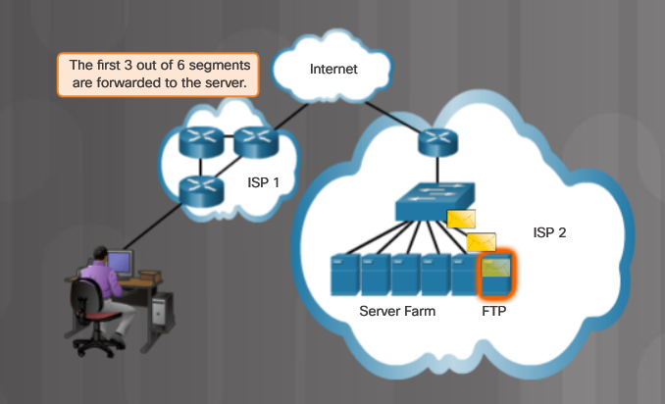
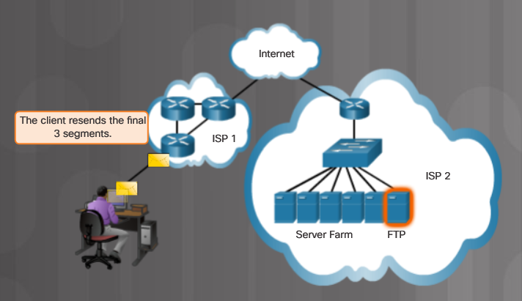
Transport Layer Protocols TCP
Three basic operations of reliability
Numbering and tracking of data segments
Acknowledgment of received data
Retransmitting any unacknowledged data after a period of time.
Notes:
5.2 – Network Protocols, Standards, and Services
5.2.1 – Transport Layer Protocols
5.2.1.4 – TCP

Slide 21
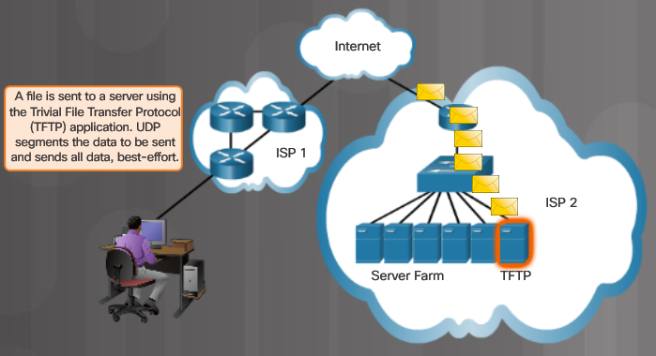
Transport Layer Protocols UDP
Very little overhead or data checking
Best-effort delivery protocol (unreliable)
No acknowledgment that the data is received by the destination
Notes:
5.2 – Network Protocols, Standards, and Services
5.2.1 – Transport Layer Protocols
5.2.1.5 – UDP
5.2.1.6 – Check Your Understanding – Transport Layer Protocols

Slide 22
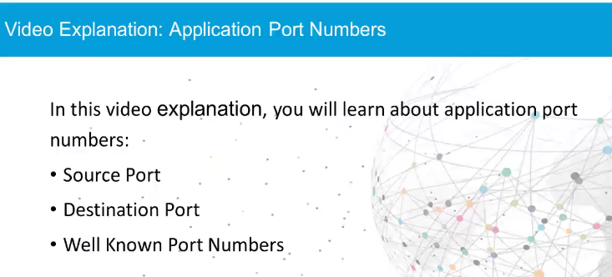
Transport Layer Protocols Video Explanation – Application Port Numbers
Notes:
5.2 – Network Protocols, Standards, and Services
5.2.2 – Application Port Numbers
5.2.2.1 – Video Explanation – Application Port Numbers

Slide 23
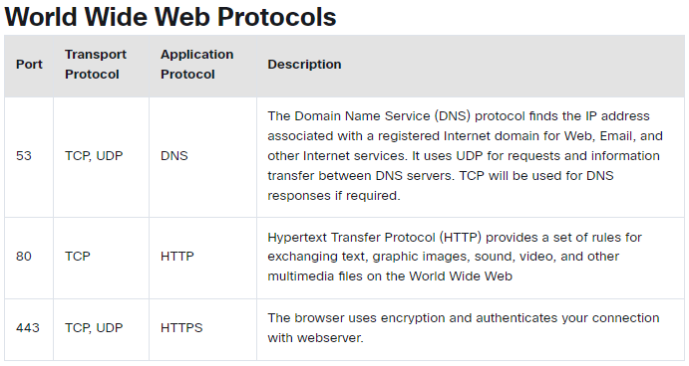
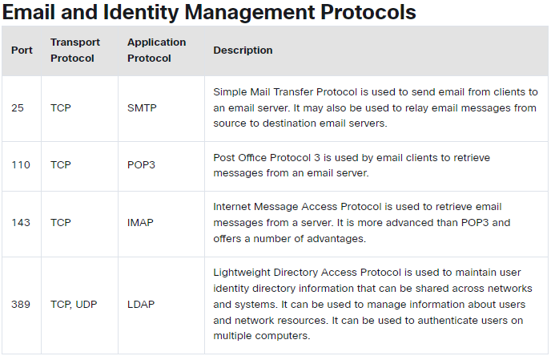
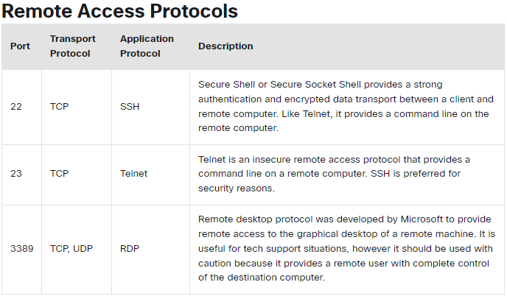
Application Port Numbers Classify Application Port Numbers
Notes:
5.2 – Network Protocols, Standards, and Services
5.2.2 – Application Port Numbers
5.2.2.2 – Classify Application Port Numbers

Slide 24
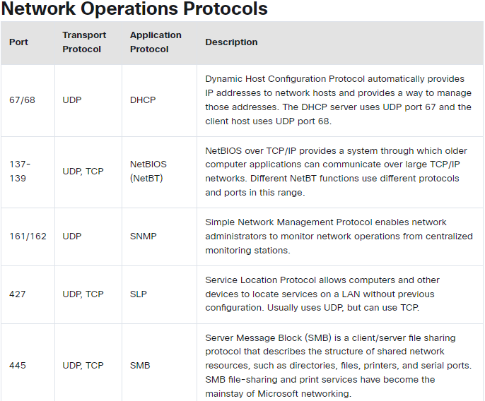
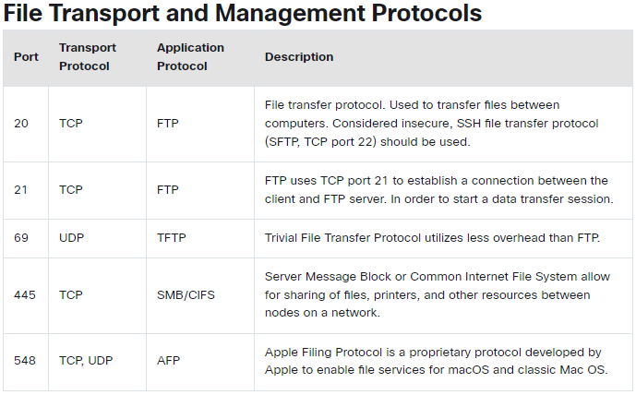
Application Port Numbers Classify Application Port Numbers (Cont.)
Notes:
5.2 – Network Protocols, Standards, and Services
5.2.2 – Application Port Numbers
5.2.2.2 – Classify Application Port Numbers (Cont.)
5.2.2.3 – Check Your Understanding – Application Port Numbers

Slide 25
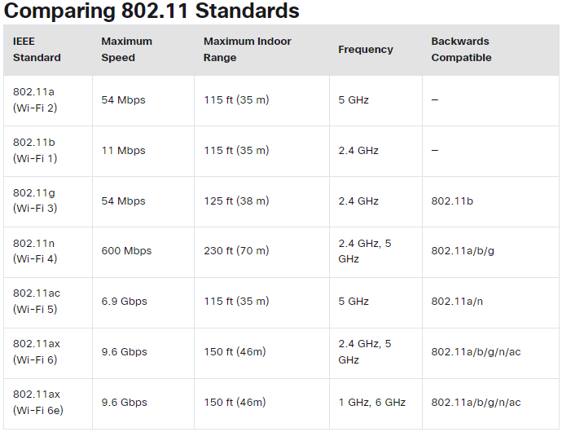
Wireless Protocols WLAN Protocols
Notes:
5.2 – Network Protocols, Standards, and Services
5.2.3 – Wireless Protocols
5.2.3.1 – WLAN Protocols

Slide 26
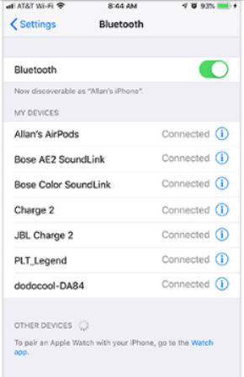


Wireless Protocols Bluetooth, NFC, and RFID
Bluetooth
Up to 7 devices to create a PAN
802.15.1
2.4 to 2.485 GHz radio frequency range
RFID
Passive or active tags used to identify items
Passive – rely on RFID reader to activate and read
Active – have a battery to broadcast the ID up to 100 meters
125 MHz to 960 MHz radio frequency range
NFC (Near Field Communication)
Devices must be in close proximity to exchange data
Used for payments, printing, public parking, etc.
Notes:
5.2 – Network Protocols, Standards, and Services
5.2.3 – Wireless Protocols
5.2.3.2 – Bluetooth, NFC, and RFID

Slide 27

Wireless Protocols Zigbee and Z-Wave
Zigbee
Requires a ZigBee Coordinator to manage client devices connected in a wireless mesh network.
Devices commonly managed from a cell phone app
IEEE 802.15.4 standard
868 MHz to 2.4 GHz range up to 20 meters, 65,000 devices, and data speeds up to 250 kb/s
Z-Wave
Proprietary standard, but public version available
232 devices can connect to a wireless mesh network with data speeds up to 100 kb/s.
Notes:
5.2 – Network Protocols, Standards, and Services
5.2.3 – Wireless Protocols
5.2.3.3 – Zigbee and Z-Wave

Slide 28
Wireless Protocols Cellular Generations
1G/2G – First generation was analog calls only. 2G introduced digital voice, conference calls, and caller ID with speeds less than 9.6 Kb/s
2.5G – supports web browsing, short audio and video clips with speeds up to 237 Kb/s.
3G – full motion video and streaming music at speeds up to 2 Mb/s.
3.5G – supports high-quality streaming video, high-quality video conferencing, and VoIP, at speeds up to 16 Mb/s.
4G - IPv6, IP-based voice, gaming services, high quality multimedia at speeds up to 672 Mb/s.
LTE (Long Term Evolution) – means it meets the 4G speed standards and improves connectivity while in motion. Speeds up to 100 Mb/s when mobile and up to 1 Gb/s when stationary.
5G – supports augmented reality (AR), virtual reality (VR), smart homes, smart cars, and data transfer between devices. Download speeds up to 3 Gb/s; upload speeds up to 1.5 Gb/s.
6G – is currently in development. As of late 2022, no standard yet exists. It will support even faster speeds required for AR/VR applications, AI applications, and instantaneous communications.
Notes:
5.2 – Network Protocols, Standards, and Services
5.2.3 – Wireless Protocols
5.2.3.4 – Cellular Generations
5.2.3.5 – Check Your Understanding – Wireless Protocols

Slide 29
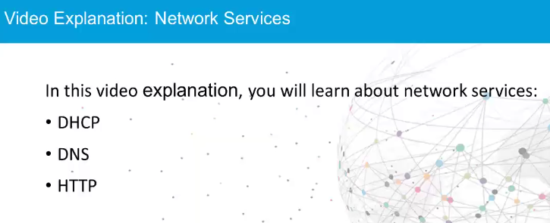
Network Services Video Explanation – Network Services
Notes:
5.2 – Network Protocols, Standards, and Services
5.2.4 – Network Services
5.2.4.1 – Video Explanation – Network Services

Slide 30
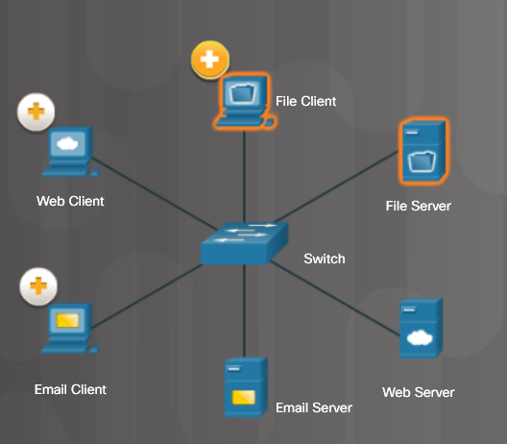
Network Services Client – Server Roles
File Client and Server
Web Client and Server
Email Client and Server
Notes:
5.2 – Network Protocols, Standards, and Services
5.2.4 – Network Services
5.2.4.2 – Client – Server Roles

Slide 31
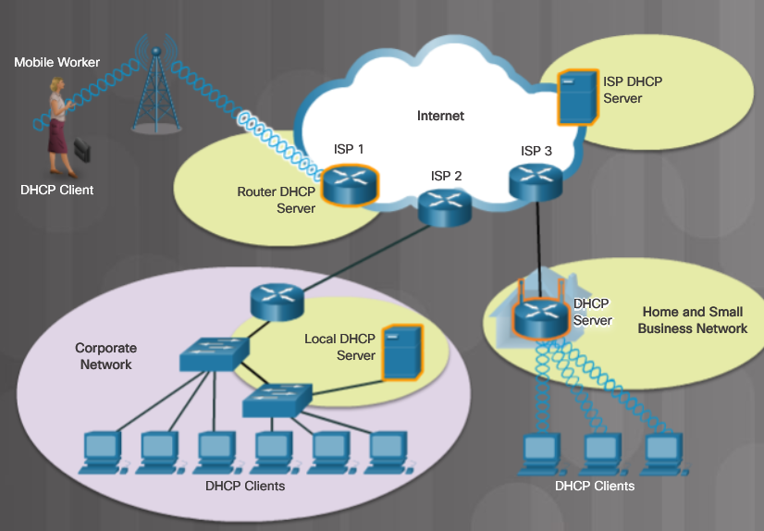
Network Services DHCP Server
A host needs IP address information before it can send data on the network.
DHCP is the service used by ISPs, network administrators, and wireless routers to automatically assign IP addressing information to hosts, as shown in the figure.
Notes:
5.2 – Network Protocols, Standards, and Services
5.2.4 – Network Services
5.2.4.3 – DHCP Server

Slide 32
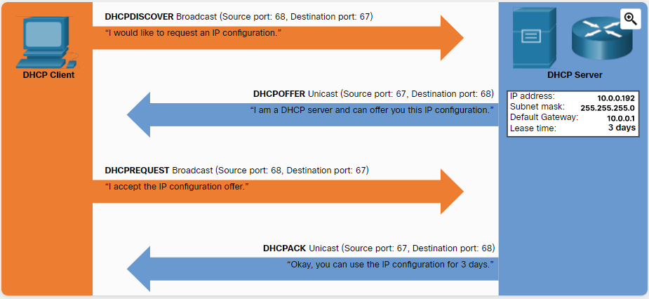
Network Services DHCP Server (Cont.)
DHCP works in a client/server mode, where DHCP clients request available IP configurations from a DHCP server.
A DHCP server is configured with a scope (i.e., a pool or a range) of addresses that it can lease to requesting DHCP clients.
As shown in the figure, when the DHCP client boots (or otherwise wants to join a network), it initiates the following four-step process to obtain a lease.
Notes:
5.2 – Network Protocols, Standards, and Services
5.2.4 – Network Services
5.2.4.3 – DHCP Server (Cont.)

Slide 33
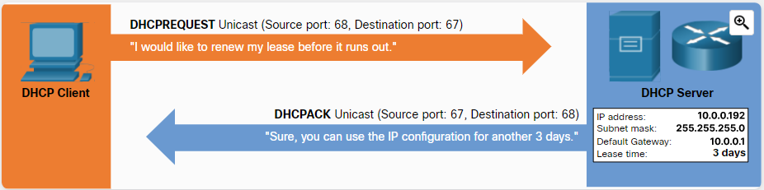
Network Services DHCP Server (Cont.)
The client must contact the DHCP server periodically to extend the lease.
This lease mechanism ensures that moved or power-off clients do not keep addresses that they no longer need.
When a lease expires, the DHCP server returns the address to the pool where it can be reallocated as necessary.
Notes:
5.2 – Network Protocols, Standards, and Services
5.2.4 – Network Services
5.2.4.3 – DHCP Server (Cont.)

Slide 34
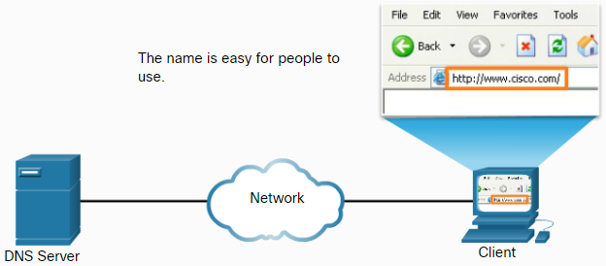
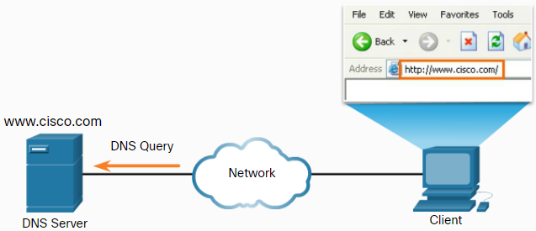
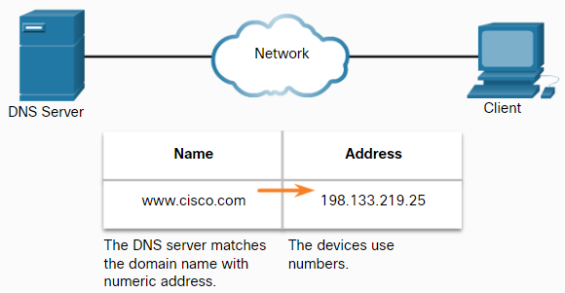
Network Services DNS Server
A DNS server translates domain names such as cisco.com to an IP address.
The five steps in the DNS resolution process are:
Step 1
Step 3
Step 2
Notes:
5.2 – Network Protocols, Standards, and Services
5.2.4 – Network Services
5.2.4.4 – DNS Server

Slide 35
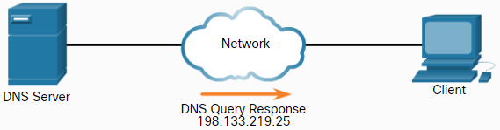
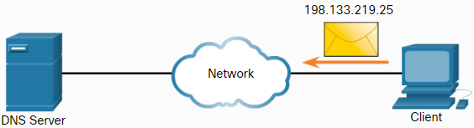
Network Services DNS Server (Cont.)
The five steps in the DNS resolution process are:
Step 4
Step 5
The number is returned back to the client for use in making requests of the server.
A domain name is resolved to its numeric network device address by the DNS protocol.
Notes:
5.2 – Network Protocols, Standards, and Services
5.2.4 – Network Services
5.2.4.4 – DNS Server (Cont.)

Slide 36
Network Services Print Server
A print server
Can control multiple printers
Provides client access to print resources
Allows centralized print job administration
Provides feedback to network clients
Notes:
5.2 – Network Protocols, Standards, and Services
5.2.4 – Network Services
5.2.4.5 – Print Server

Slide 37
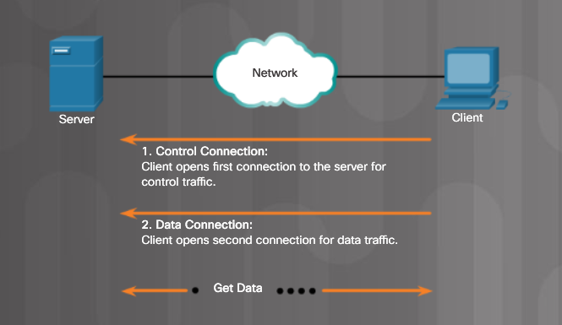
Network Services File Server
A file server allows clients to access files using a specific protocol
FTP (File Transfer Protocol)
FTPS (File Transfer Protocol Secure)
SFTP (Secure Shell File Transfer Protocol)
SCP (Secure Copy)
Notes:
5.2 – Network Protocols, Standards, and Services
5.2.4 – Network Services
5.2.4.6 – File Server

Slide 38
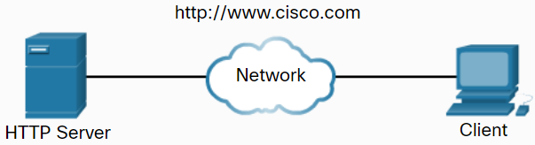
Network Services Web Server
A web server provides web resources using these protocols
Hypertext Transfer Protocol (HTTP) operating on TCP port 80
Secure HTTP (HTTPS) using Secure Sockets Layer (SSL) or Transport Layer Security (TLS) operating on TCP port 443
How a web page is opened in a browser:
For this example, use the http://www.cisco.com/index.html URL.
First, the browser interprets the three parts of the URL:
http (the protocol or scheme)
www.cisco.com (the server name)
index.html (the specific filename requested)
The browser then checks with a DNS to convert www.cisco.com into a numeric address, which it uses to connect to the server.
Notes:
5.2 – Network Protocols, Standards, and Services
5.2.4 – Network Services
5.2.4.7 – Web Server

Slide 39
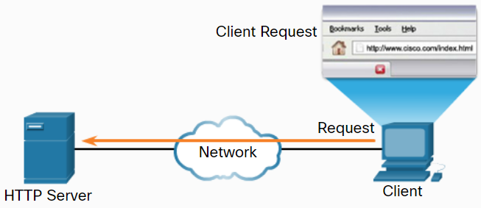
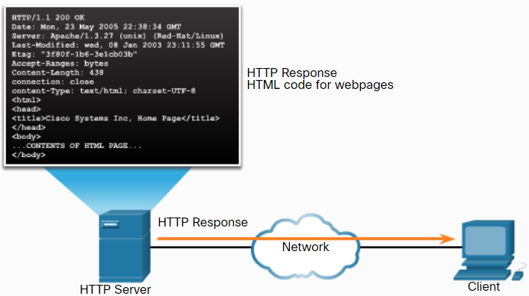
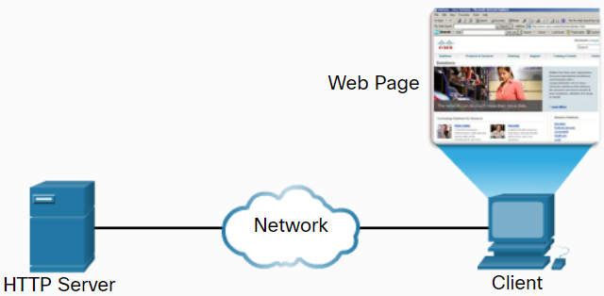
Network Services Web Server (Cont.)
Step 1: Using HTTP requirements, the browser sends a GET request to the server and asks for the index.html file.
Step 2: The server sends the HTML code for this web page back to the client’s browser.
Step 3: The browser interprets the HTML code and formats the page for the browser window.
Step 1
Step 2
Step 3
Notes:
5.2 – Network Protocols, Standards, and Services
5.2.4 – Network Services
5.2.4.7 – Web Server (Cont.)

Slide 40
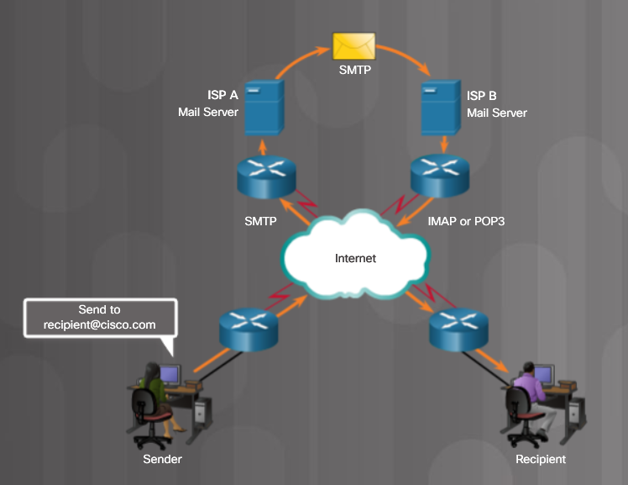
Network Services Mail Server
Email messages are stored in databases on mail servers
Client communicates with server in order to reach a different client
Protocol used to send email
Simple Mail Transfer Protocol (SMTP)
Protocols used to retrieve email
Post Office Protocol (POP)
Internet Message Access Protocol (IMAP)
Notes:
5.2 – Network Protocols, Standards, and Services
5.2.4 – Network Services
5.2.4.8 – Mail Server

Slide 41
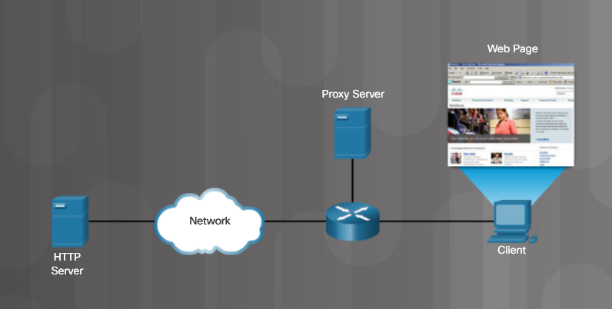
Network Services Proxy Server
Proxy servers act on behalf of a client, thus hiding the real internal host
Used to cache frequently accessed web pages
Notes:
5.2 – Network Protocols, Standards, and Services
5.2.4 – Network Services
5.2.4.9 – Proxy Server

Slide 42

Network Services Authentication Server
Authentication, Authorization, and Accounting (AAA) - Allows access to a network device or a particular network
Notes:
5.2 – Network Protocols, Standards, and Services
5.2.4 – Network Services
5.2.4.10 – Authentication Server

Slide 43

Network Services Syslog Server
Syslog stores network messages sent by networking devices.
Notes:
5.2 – Network Protocols, Standards, and Services
5.2.4 – Network Services
5.2.4.11 – Syslog Server

Slide 44
Network Services Load Balancer
Some network servers can experience very heavy loads.
Some examples include streaming media servers, web servers, and email servers.
Often, multiple servers are providing one service in order to provide timely content.
A load balancer can be used distribute the demand of requests.
It is placed in front of the servers to ensure each server is being used as much as the others.
This prevents things like network timeouts and slow responses.
Notes:
5.2 – Network Protocols, Standards, and Services
5.2.4 – Network Services
5.2.4.12 – Load Balancer

Slide 45
Network Services Scada
A Supervisory Control and Data Acquisition (SCADA) system is used in an industrial control system (ICS).
This type of system provides automation for critical services such as national security, water treatment plants, or power suppliers.
SCADA software runs on a computer to gather data from the devices used by the ICS.
The SCADA manages the devices remotely typically through the use of satellite or cellular communications.
Notes:
5.2 – Network Protocols, Standards, and Services
5.2.4 – Network Services
5.2.4.13 – Scada
5.2.4.14 – Check Your Understanding – Network Services

Slide 46
5.3 Basic Network Devices
Notes:
5 – Networking Concepts
5.3 – Basic Network Devices

Slide 47

Basic Network Devices Video Explanation - Basic Network Devices
Notes:
5.3 – Network Devices
5.3.1 – Basic Network Devices
5.3.1.1 – Video Explanation – Basic Network Devices

Slide 48

Basic Network Devices Network Interface Card
Todays computers have wired and/or wireless network capability.
Notes:
5.3 – Network Devices
5.3.1 – Basic Network Devices
5.3.1.2 – Network Interface Card

Slide 49



Basic Network Devices Repeaters, Bridges, and Hubs
Repeaters – Also called extenders because they regenerate the signal so it can be sent further.
Hub – Receives data on one port and sends to all other ports.
Bridge – Divides a network into two or more segments and tracks which device is on each segment.
Notes:
5.3 – Network Devices
5.3.1 – Basic Network Devices
5.3.1.3 – Repeaters, Bridges, and Hubs

Slide 50

Basic Network Devices Switches
Ethernet switches record MAC addresses for each device connected to the switch.
Data is sent to a specific device if the MAC address of that device is in the MAC address table.
Managed switches are used in a company environment and have additional features.
Unmanaged switches are used in home or a small business network.
Notes:
5.3 – Network Devices
5.3.1 – Basic Network Devices
5.3.1.4 – Switches

Slide 51

Basic Network Devices Wireless Access Points
Wireless access points (APs) – provide access to a wireless network for a limited range.
Notes:
5.3 – Network Devices
5.3.1 – Basic Network Devices
5.3.1.5 – Wireless Access Points

Slide 52

Basic Network Devices Routers
Routers connect networks.
Use an IP address to forward traffic to other networks
Can be a multipurpose device (integrated router) that includes switching and wireless capabilities
Notes:
5.3 – Network Devices
5.3.1 – Basic Network Devices
5.3.1.6 – Routers
5.3.1.7 – Check Your Understanding – Traditional Network Devices

Slide 53

Security Devices Video Explanation – Security Devices
Notes:
5.3 – Network Devices
5.3.2 – Security Devices
5.3.2.1 – Video Explanation – Security Devices

Slide 54

Security Devices Firewalls
A firewall protects data and devices connected to a network.
Firewalls use access control lists (ACLs) which are rules used to determine whether data is permitted (allowed through) or denied.
Notes:
5.3 – Network Devices
5.3.2 – Security Devices
5.3.2.2 – Firewalls

Slide 55


Security Devices IDS and IPS
An Intrusion Detection System (IDS) monitors traffic and is a passive system.
An Intrusion Prevention System (IPS) actively monitors traffic and takes action when needed.
Notes:
5.3 – Network Devices
5.3.2 – Security Devices
5.3.2.3 – IDS and IPS

Slide 56

Security Devices UTMs
Universal Threat Management (UTM) is an all-in-one security appliance. Features are vendor-specific, but could include:
Firewall services
IDS/IPS services
Additional security services against Zero Day, Denial of Service (DoS) Distributed Denial of Service (DDoS), and spyware
Proxy and email filtering
Network access control
VPN services
Notes:
5.3 – Network Devices
5.3.2 – Security Devices
5.3.2.4 – UTMs

Slide 57

Security Devices Endpoint Management Server
An endpoint management server monitors end devices such as PCs, laptops, servers, tablets, printers, etc.
Notes:
5.3 – Network Devices
5.3.2 – Security Devices
5.3.2.5 – Endpoint Management Server

Slide 58

Security Devices Spam Management
The DNS service is commonly abused by threat actors to assist in their SPAM email campaigns.
For this reason, DNS servers now use TXT resource records to implement the anti-spam security features detailed in the table.
Notes:
5.3 – Network Devices
5.3.2 – Security Devices
5.3.2.6 – Spam Management
5.3.2.7 – Check Your Understanding – Security Devices

Slide 59

Other Network Devices Legacy and Embedded Systems
A legacy system is a device on the network no longer supported, but still in operation.
An embedded system is a device built into something else such as an appliance. Embedded microchips are contained in legacy systems and embedded systems.
Legacy systems and embedded systems could be a security risk.
Notes:
5.3 – Network Devices
5.3.3 – Other Network Devices
5.3.3.1 – Legacy and Embedded Systems

Slide 60

Other Network Devices Patch Panel
A centralized place where network cables attach to the back. Patch cables are used to make a connection to another patch panel which connects to a different wiring closet, or to a device such as a switch mounted nearby.
Notes:
5.3 – Network Devices
5.3.3 – Other Network Devices
5.3.3.2 – Patch Panel

Slide 61



Other Network Devices Power over Ethernet and Ethernet over Power
PoE injector
PoE devices like PoE switches, PoE injectors, IP cameras, Voice over IP (VoIP) phones, and wireless access points (WAPs) are the top five most popular devices.
Power can also be inserted in the middle of a cable run using a PoE injector.
There are several IEEE standards for PoE:
802.3af – Can supply up to 13 watts as 350mA at 48 volts.
802.3at (PoE+) – Can supply up to 25 watts as 600 mA.
802.3bt (PoE++ or 4PPoE) – Can supply 51 watts (Type 3) or 73 watts (Type 4)
PoE switch
Network cable
Ethernet over Power (powerline networking) uses existing electrical wiring to create a network.
Notes:
5.3 – Network Devices
5.3.3 – Other Network Devices
5.3.3.3 – Power over Ethernet and Ethernet over Power

Slide 62

Other Network Devices Cloud-based Network Controller
A cloud-based network controller is a remote device used to manage network devices like access points or switches.
Notes:
5.3 – Network Devices
5.3.3 – Other Network Devices
5.3.3.4 – Cloud-based Network Controller
5.3.3.5 Check Your Understanding – Other Network Devices

Slide 63
5.4 Network Cables
Notes:
5 – Networking Concepts
5.4 – Network Cables

Slide 64

Network Tools Video Explanation – Network Cable Tools
Notes:
5.4 – Network Cables
5.4.1 – Network Tools
5.4.1.1 – Video Explanation – Network Cable Tools

Slide 65




Network Tools Network Tools and Descriptions
Wire cutters or side cutters
Wire strippers
Crimper – used to securely attach an RJ-45 connector
Punch down tool – used to terminate wires into termination
Notes:
5.4 – Network Cables
5.4.1 – Network Tools
5.4.1.2 – Network Tools and Descriptions

Slide 66





Network Tools Network Tools and Descriptions (Cont.)
Multimeter
Tone Generator
Loopback adapter – used to check a port
Cable Tester
Wi-Fi analyzer
Notes:
5.4 – Network Cables
5.4.1 – Network Tools
5.4.1.2 – Network Tools and Descriptions (Cont.)

Slide 67
Copper Cables and Connectors Network Taps
Sometimes it is necessary to capture network traffic to analyze it, and this can often be done with software such as Wireshark.
If this is not possible, a network tap can be used to capture the cable signals and send them to analyzing software.
A network tap can be passive or active (powered):
Passive test access point (TAP) - This type of TAP is a box with network ports to carry signals in and out. Inside, an inductor or optical splitter is used to copy the signal and send it out a monitor port. The monitor port receives all the traffic from the cable.
Active TAP - This type of TAP regenerates the signal. Due to the complexity of gigabit signaling, a passive TAP is unable to be used. Also, some fiber links may become corrupt using an optical splitter, so an active TAP is used instead.
Network sniffing can also be completed using a special port on a network switch, knowning as a switched port analyzer (SPAN)/mirror port.
A mirror receives a copy of the traffic that are addressed to a specific port or all other ports.
Notes:
5.4 – Network Cables
5.4.2 – Copper Cables and Connectors
5.4.1.3 – Network Taps
5.4.1.4 – Check Your Understanding – Network Tools

Slide 68

Copper Cables and Connectors Cable Types
Cable types used in networking
Twisted-pair
Coaxial
Fiber-optic
Notes:
5.4 – Network Cables
5.4.2 – Copper Cables and Connectors
5.4.2.1 – Cable Types

Slide 69

Copper Cables and Connectors Coaxial Cables
Coaxial cable
Copper or aluminum
Used in cable TV systems and satellite communication systems
Harder to install, more expensive, and harder to troubleshoot than twisted-pair cabling
Notes:
5.4 – Network Cables
5.4.2 – Copper Cables and Connectors
5.4.2.2 – Coaxial Cables

Slide 70



Copper Cables and Connectors Twisted-Pair Cables
Twisted-pair cabling types
Unshielded twisted-pair (UTP)
Shielded twisted-pair (STP)
UTP
Most common
Four pairs of color-coded wires
Prone to electromagnetic interference (EMI) and radio frequency interference (RFI)
STP
Better protection against EMI and RFI
More expensive and harder to install
UTP cabling
STP cabling
Notes:
5.4 – Network Cables
5.4.2 – Copper Cables and Connectors
5.4.2.3 – Twisted-Pair Cables

Slide 71



Copper Cables and Connectors Twisted-Pair Category Ratings
Cat 5 UTP
Cat 5e UTP
Cat 6 UTP
Notes:
5.4 – Network Cables
5.4.2 – Copper Cables and Connectors
5.4.2.4 – Twisted-Pair Category Ratings

Slide 72




Copper Cables and Connectors Twisted-Pair Wire Schemes
T568A
T568B
When creating a cable to connect a network device to a wall jack or from the patch panel to a switch, make both ends of the cable the same standard.
Notes:
5.4 – Network Cables
5.4.2 – Copper Cables and Connectors
5.4.2.5 – Twisted-Pair Wire Schemes
5.4.2.6 – Activity – T568A Cable Pinouts and T568B Cable Pinouts

Slide 73

Copper Cables and Connectors Video Explanation – Build and Test a Network Cable
Notes:
5.4 – Network Cables
5.4.2 – Copper Cables and Connectors
5.4.2.7 – Video Explanation – Build and Test a Network Cable

Slide 74
Copper Cables and Connectors Lab – Build and Test Network Cables
In this lab, you will build and test a straight-through Unshielded Twisted-Pair (UTP) Ethernet network cable.
Note: With a straight-through cable, the color of wire used by pin 1 on one end is the same color used by pin 1 on the other end, and similarly for the remaining seven pins. The cable will be constructed using either TIA/EIA T568A or T568B standards for Ethernet. This determines which color wire is to be used on each pin.
Straight-through cables are normally used to connect a host directly to a switch or a wall plate in an office area.
Notes:
5.4 – Network Cables
5.4.2 – Copper Cables and Connectors
5.4.2.8 – Lab – Build and Test Network Cables

Slide 75

Fiber Cables and Connectors Fiber-Optic Cables
Fiber-Optic cables
Use light to transmit signals
Not affected by EMI or RFI
Notes:
5.4 – Network Cables
5.4.3 – Fiber Cables and Connectors
5.4.3.1 – Fiber-Optic Cables

Slide 76


Fiber Cables and Connectors Types of Fiber Media
Single-mode fiber (SMF)
Small core
Uses laser technology to send one beam of light
Long distances
Multimode fiber (MMF)
Larger core
Uses LEDs to send light
Light is injected at different angles
Cheaper
Bandwidth up to 10 Gb/s up to 550 meters
SMF
MMF
Notes:
5.4 – Network Cables
5.4.3 – Fiber Cables and Connectors
5.4.3.2 – Types of Fiber Media

Slide 77

Fiber Cables and Connectors Fiber-Optic Connectors
Notes:
5.4 – Network Cables
5.4.3 – Fiber Cables and Connectors
5.4.3.3 – Fiber-Optic Connectors
5.4.3.4 – Check Your Understanding – Fiber Cables and Connectors

Slide 78
5.5 Chapter Summary
Notes:
5 – Networking Concepts
5.5 – Summary

Slide 79
Conclusion Chapter 5: Network Concepts
Explain components and types of computer networks.
Explain networking protocols, standards and services.
Explain the purpose of devices on a network.
Explain the characteristics of network cables.
Notes:
5.5 – Summary
5.5.1 – Conclusion
5.5.5.1 – Chapter 5: Network Concepts

Slide 80
Section 5.5 New Terms and Commands
PAN LAN VLAN WLAN WMN MAN WAN VPN SVI VLAN DSL Cable Fiber Line of Sight Wireless | Satellite Cellular Mobile hotspot and tethering TCP UDP Port numbers 802.11 WLAN protocol Bluetooth NFC RFID Zigbee Z-Wave 1G/2G, 2.5G, 3G, 3.5G, 4G, LTE, and 5G | Client-Server roles DHCP server DNS server Print server File server Web server Mail server Proxy server Authentication server Syslog server NIC Repeater Bridge Hub
Notes:
Chapter 5 - New Terms and Commands

Slide 81
Section 5.5 New Terms (cont.)
Switch Wireless access point Router Firewall IDS IPS UTM Endpoint management server Legacy system Embedded system Patch panel Power over Ethernet Ethernet over Power Cloud-based network controller | Wire cutter Wire stripper Crimper Punch down tool Multimeter Cable tester Loopback Tone generator Wi-Fi analyzer Coaxial cable UTP STP Fiber-optic cable T568A | T568B RJ-45 connector SMF MMF ST connector SC connector LC connector Duplex multimode LC connectors
Notes:
Chapter 5 - New Terms

